Slide 1
Introduction to Space Engineering Education at Kyushu Institute of Technology
John L. Polansky
Laboratory of Spacecraft Environment Interaction Engineering
Kyushu Institute of Technology, Kitakyushu, Japan
December 9, 2013
Mexico

Slide 2
Outline
Introduction to KIT
Introduction to LaSEINE
  Space Research
  Satellite Testing
Kyutech Satellite Projects
SEIC and PNST
Conclusion

Slide 3
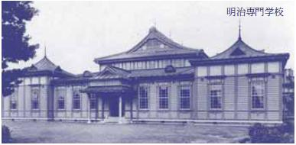

Kyushu Institute of Technology (KIT)
1909 | Founded as Meiji College of Technology (4-year, private)
1921 | Became a national institution
1949 | Renamed as Kyushu Institute of Technology
1986 | Addition of Faculty of Computer Science and Systems Engineering
2000 | Addition of Graduate School of Life Science and Systems Engineering
2004 | Became a National University Corporation
2009 | Celebration of 100th anniversary
4,400 Undergraduate students
1,700 Graduate students
370 Academic staffs
Notes:
Steel Tycoon donated money to start Kyutech as private university.
About 80 Japanese national universities, ~500-600 private universities.

Slide 4
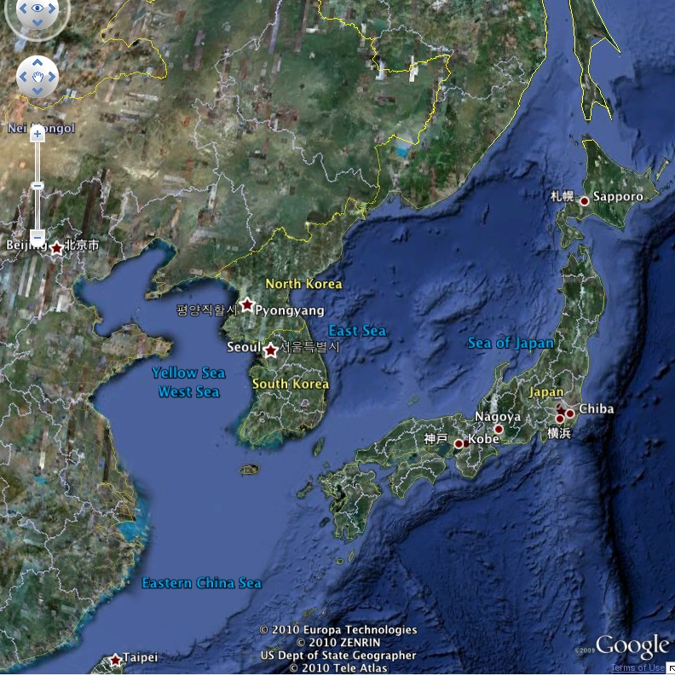
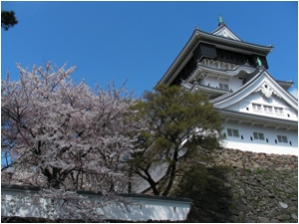
Kyushu Institute of Technology
Located at Kitakyushu region
  Population of more than 1million
  Cost of living is much lower than Tokyo
~1000km
Tokyo
Kitakyushu
Notes:
Birthplace of Japanese heavy industry- steel industry- China close by and lots of coal mines.

Slide 5
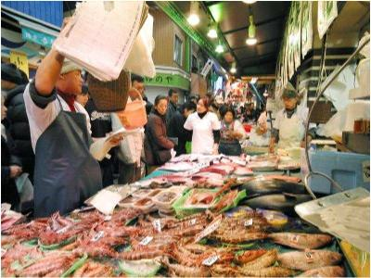

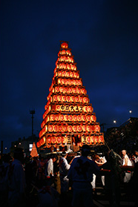
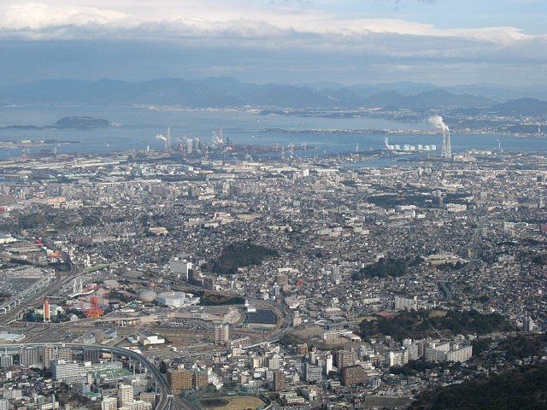
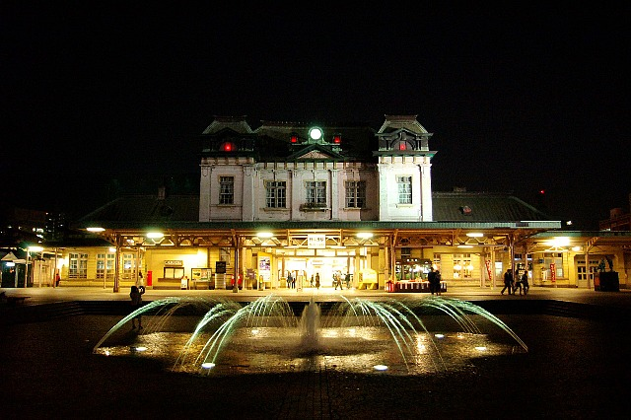
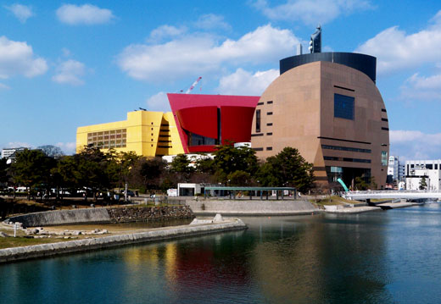
City of Kitakyushu

Slide 6
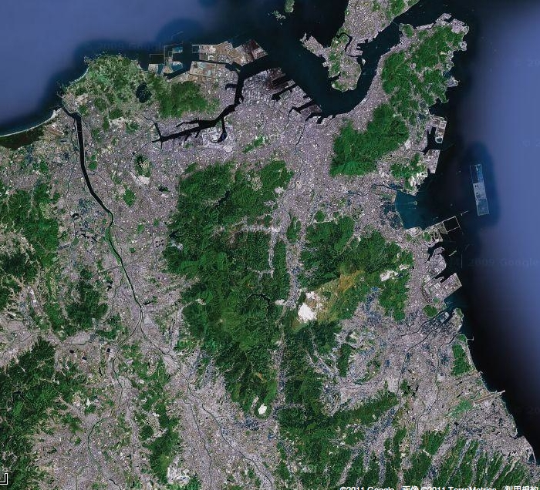
Kyushu Institute of Technology
Wakamatsu – Life Science
10km
Tobata - Engineering
30km
Iizuka – Computer Science
©Google

Slide 7
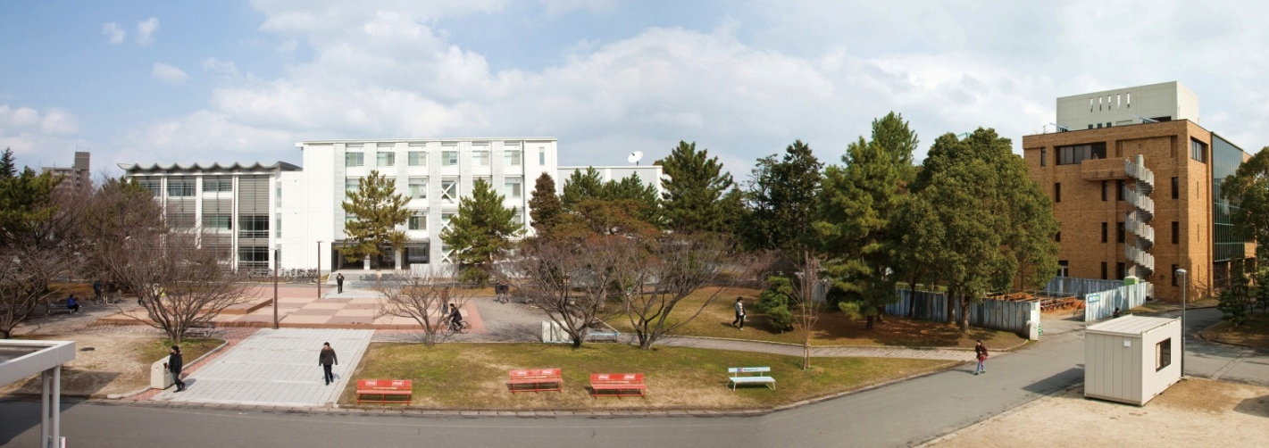
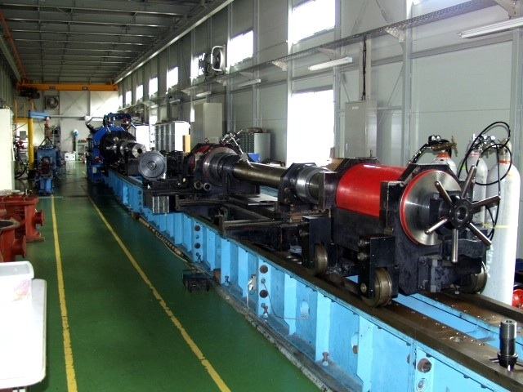
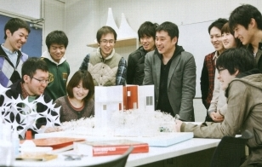
Tobata Campus (Engineering)
Mechanical and Control Engineering
Civil Engineering
Electrical and Electronic Engineering
Applied Chemistry
Material Engineering
Systems Engineering
Prof. Mengu Cho belongs to this

Slide 8
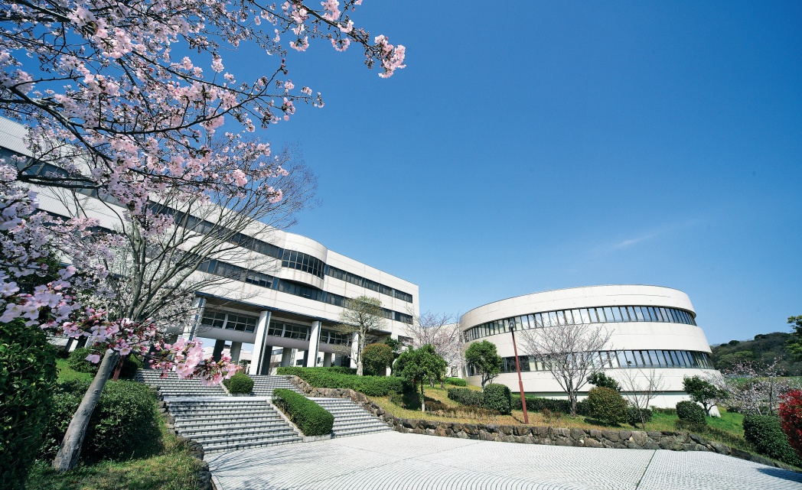
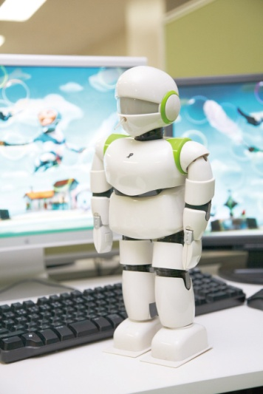
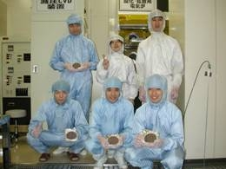
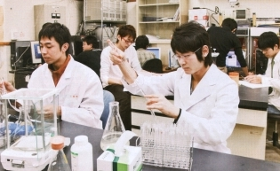
Iizuka Campus (Computer Science)
Computer Science and Electronics
Systems Innovation and Informatics
Mechanical Information Science & Technology
Bioscience and Bioinformatics
Artificial Intelligence

Slide 9
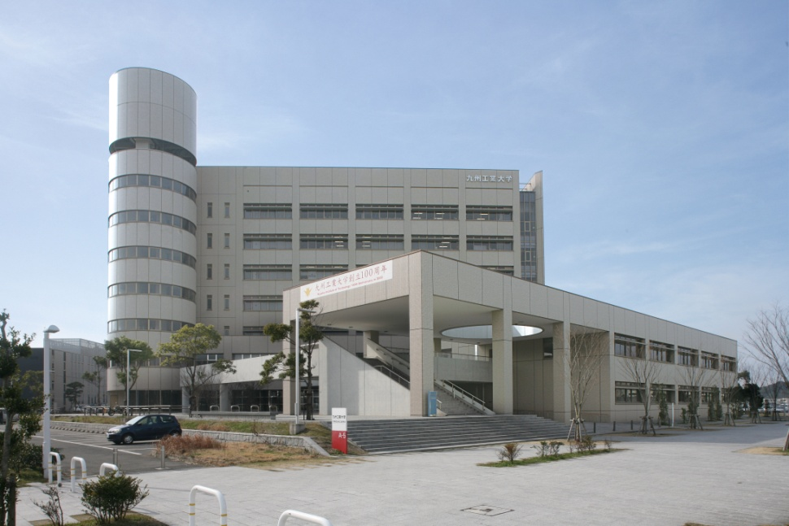
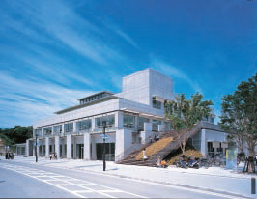
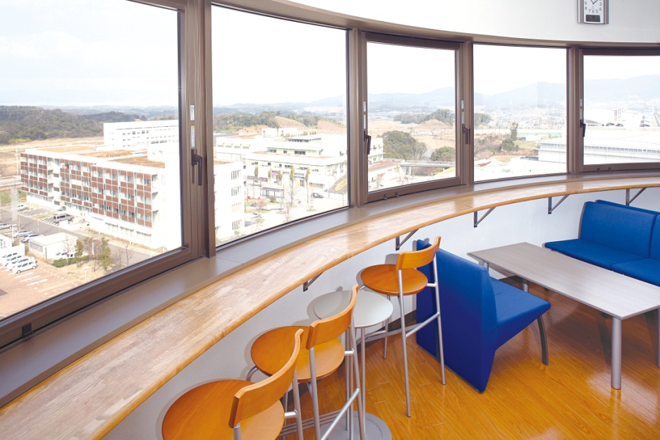
Wakamatsu Campus (Life Science)
Biological Functions Engineering
Brain Science

Slide 10























International Exchange Partnerships
with 23 countries/regions and 84 universities/institutions
Countries (Regions) | # of partner institutions | Countries (Regions) | # of partner institutions
China | 16 | Taiwan | 3
U.S.A. | 6 | Malaysia | 3
Korea | 9 | Bangladesh | 1
Thailand | 5 | Pakistan | 1
Vietnam | 7 | Sri Lanka | 1
Indonesia | 4 | Philippines | 1
India | 5 | New Zealand | 2
Australia | 3 | Italy | 1
U.K. | 3 | Poland | 1
France | 5 | Norway | 1
Mongolia | 2 | Spain | 1
Germany | 3 | Total | 84
As of September 2013

Slide 11
International Students at KIT
Country (Region) | Number of Int’l students | Country (Region) | Number of Int’l students
China | 126 | Syria | 1
Malaysia | 20 | Brazil | 1
Korea | 18 | Myanmar | 1
Indonesia | 17 | Laos | 1
France | 8 | Liberia | 1
Vietnam | 7 | Algeria | 1
Thailand | 6 | Fiji | 1
Bangladesh | 6 | Egypt | 1
India | 6 | Mongolia | 1
Taiwan | 5 | Pakistan | 1
Australia | 2 | Philippines | 1
Iran | 2 | Argentina | 1
Sri Lanka | 2 | Palestine | 1
Afghanistan | 1 | Total | 238
Total of 238 international students as of May 1, 2013
Notes:
Mr. Ammarin Pimnoo

Slide 12
Outline
Introduction to KIT
Introduction to LaSEINE
  Space Research
  Satellite Testing
Kyutech Satellite Projects
SEIC and PNST
Conclusion

Slide 13

Kyushu Institute of Technology
Laboratory of Spacecraft Environment Interaction Engineering
(LaSEINE)
Inauguration: December 2004
11 academic staffs
  3 Professor, 1 Associate Professor, 3 Assistant Professor, 4 Post-docs
Annual research budget: 1 million US$ (approx.)
Notes:
LaSEINE- river in Paris- logo symbolizes the river head, growing larger
Budget- Japanese government, Japanese ministries, JAXA, NSF, industry. Funding is project-based. Pays ~6 faculty/staff member salaries.
National universities needed some “specialty” to stay competitive with private universities (deregulation in 2000’s). Kyutech president chose 3 specialties: Space, Information Technology, Biomass processing (palm oil). Kyutech budget still ~80% government funded.

Slide 14
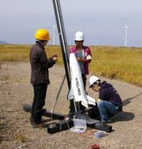
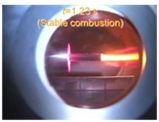
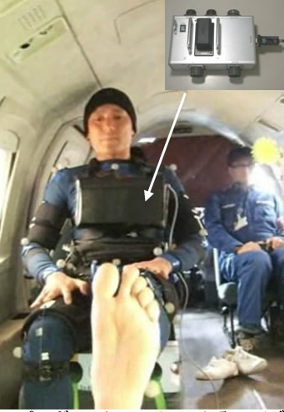
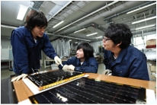
Space Engineering Research and Educations at KIT
Space Engineering Education at Tobata Campus since 1993
  Undergraduate (30 students/class) and graduate levels
Laboratory of Spacecraft Environmental Interaction Engineering
  Established in 2004
Center for Nanosatellite Testing
  Established in 2010
Member of International Astronautical Federation (IAF) since 2011
Notes:
From 1993 in Mechanical Engineering department (undergraduate education through Mechanical Engineering Department- still on going). Cho joined Kyutech in 1996.
KIT is only Japanese IAF (International Astronautical Federation) member

Slide 15
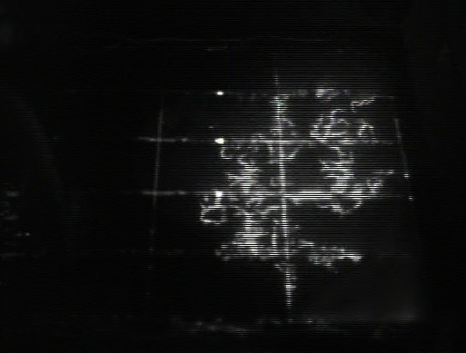
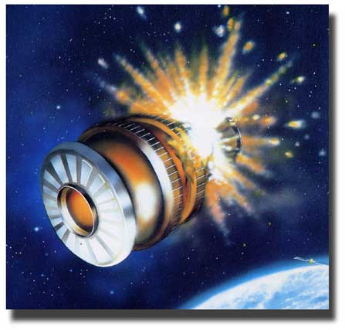
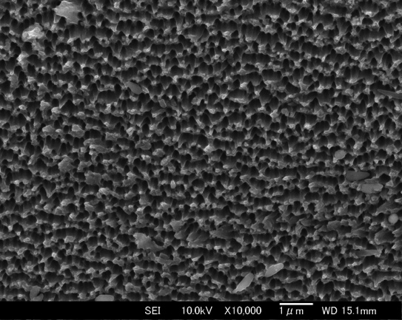
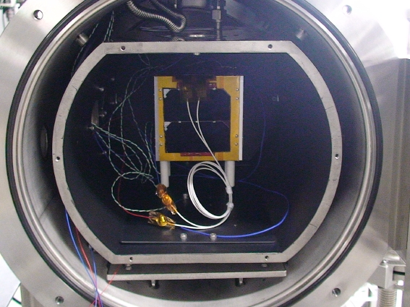
Research area
宇宙環境試験システム
Electrostatic Discharge
Hypervelocity impact
Material degradation
Nanosatellite environment test
Promote cooperative research with
  Space agency, Space industries, Local small industries, International partners
宇宙環境要因による材料の劣化

Slide 16
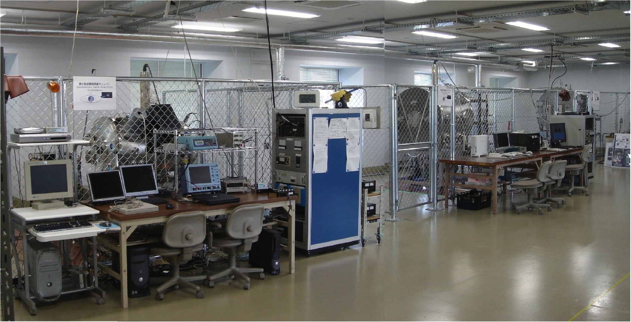
Electrostatic Discharge (ESD) Test Facilities
World leading test facility
  Leads the international ISO standardization project on satellite solar panel ESD test
One of three in the world (NASA(US) and ONERA (France))
GEO
PEO
LEO
Notes:
KIT/LaSEINE a world leader in ESD testing
Large telecommunications satellites can cost ~$300-$400M, and ESD discharges (when plasma activity drives kV spacecraft potential) can kill satellites. KIT tests satellites from all over the world (slide 18 blue names)
Major lawsuits may arise when satellite failure occurs (~$1B)

Slide 17
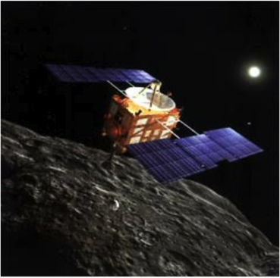
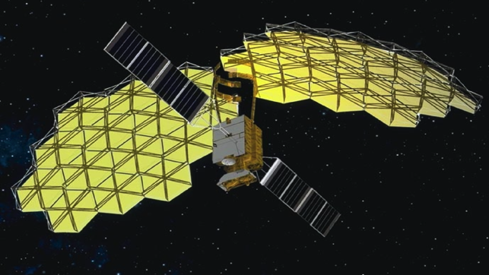
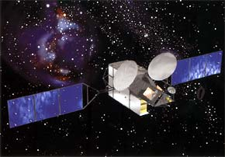
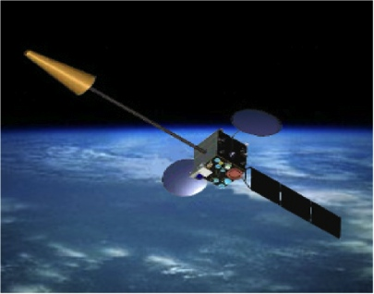
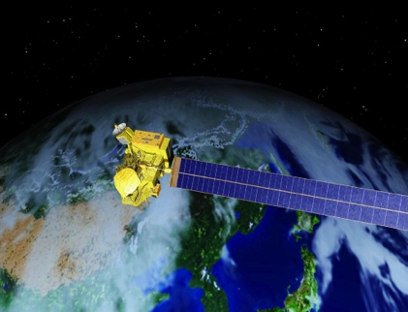
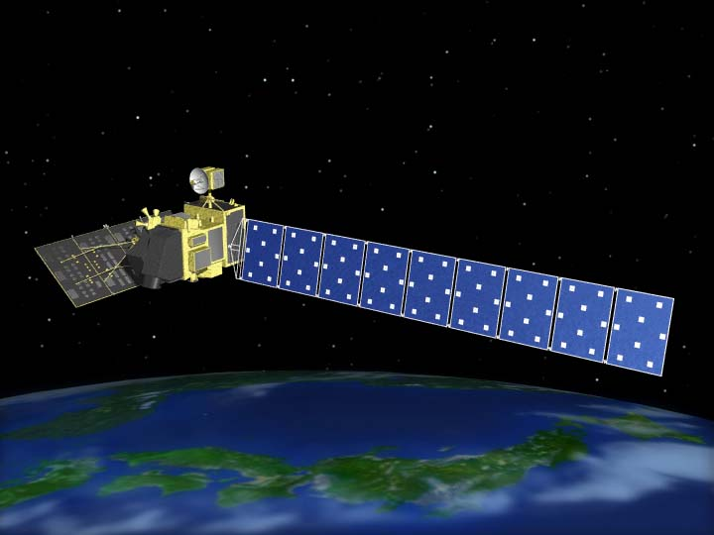
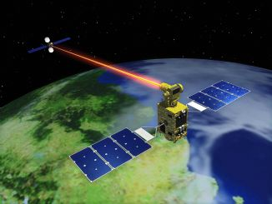
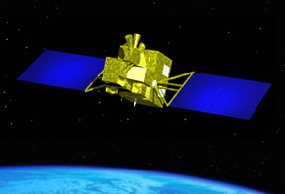
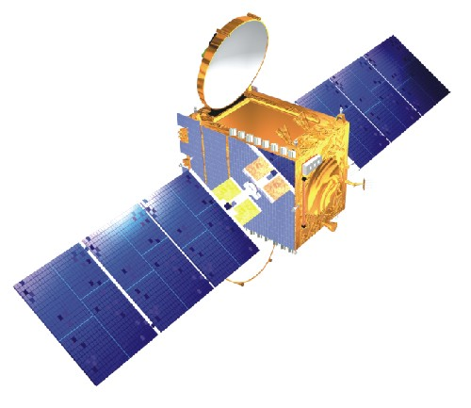
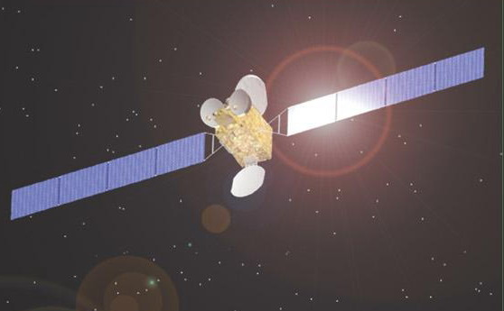
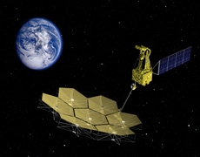
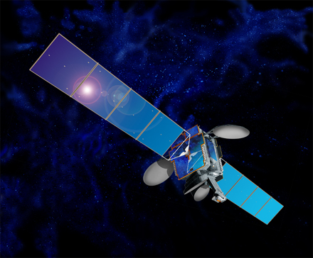
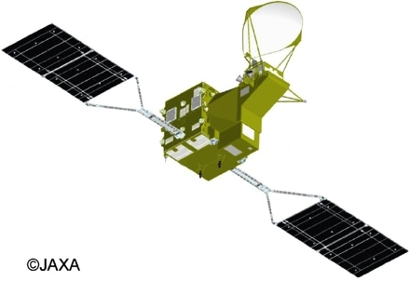
Heritage of Electrostatic Discharge (ESD) tests at KIT
Kizuna(2008)
Himawari-7 (2006)
Hayabusa(2003)
Kiku-8 (2006)
Midori2(2003)
Failure investigation
Daichi(2006)
Kirari(2005)
GOSAT(2008)
INSAT
http://www.spacechina.com/cpyjs_wxyhtq_Details.shtml?recno=48130
GCOM(2010)
ASTRO-G(2012)
©ISRO
http://www.ssloral.com/html/satexp/telstar.html
India
China
US
Tested satellites from all over the world
Notes:
To reduce cable mass, best way is to have high voltage. Reduce transmission loss from large solar panels to bus system. Same concept as earth-based power systems.
Lots of issues when voltage changed from 50V to 100V- issues linked to circuit shorts on solar array panels. Even losing 10% of power could lead to 10% of revenue loss. $30M for $300M geo satellite.
Midori2 2003 failure- linked to ESD and electrostatic charging. Previously JAXA was skeptical. Cho was one of 3 “experts” in Japan who knew what was going on. Asked to test Hayabusa (120 V, ion thruster) for ESD, etc.

Slide 18
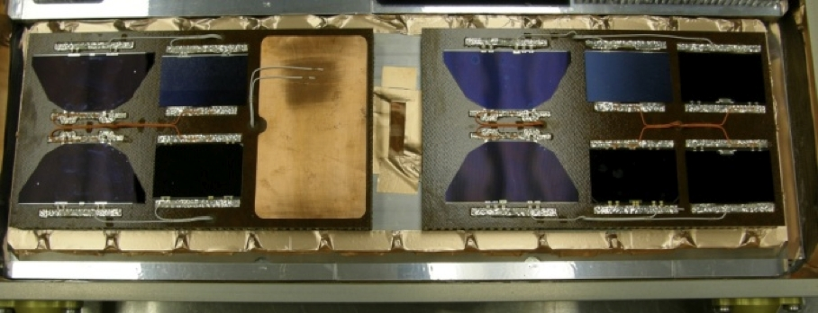
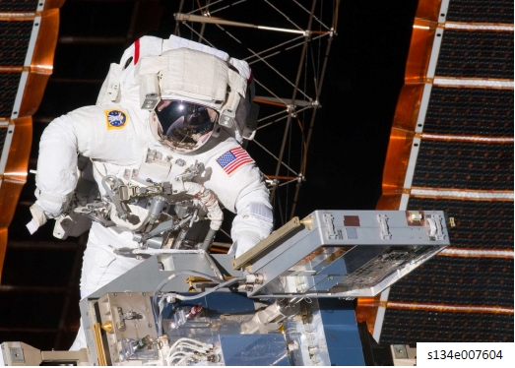
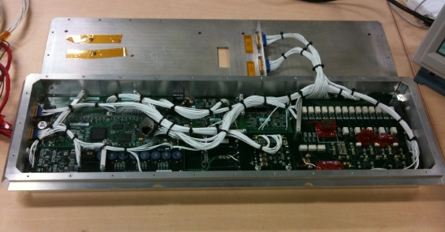
Experiment at International Space Station
Solar cells to be tested
Deployment, May, 2011
COTS based electronics designed and tested by KIT
Active experiment to confirm solar cell degradation due to a single ESD pulse
Bias solar cells to plasma, detect discharge and measure the cell VI curve
Joint experiment with Lockheed-Martin, Naval Research Laboratory, JAXA
Notes:
Very bureaucratic, ITAR, military requirements (Naval Research Laboratory), etc.
State-of-art solar cells and how they discharge in space

Slide 19
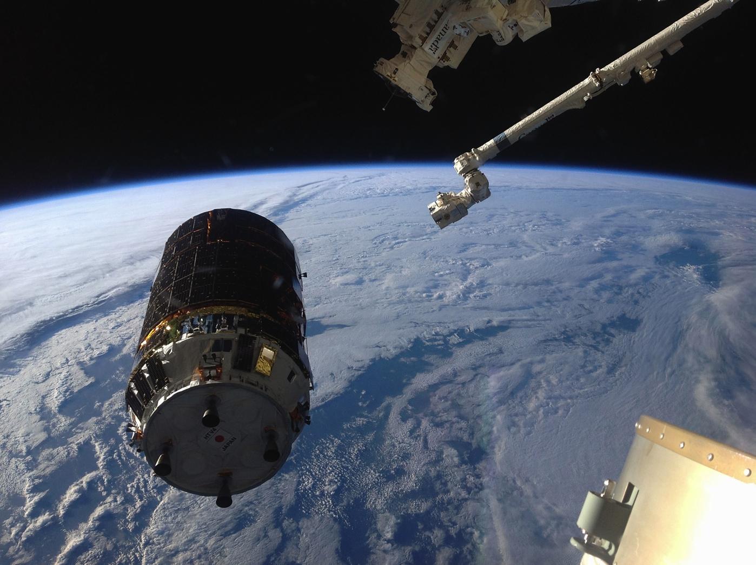
Experiment at International Space Station
HTV
ISS
Charging sensor
Launched on Aug.4, 2013
Measure the charging potential of HTV4 before, during, and after docking with ISS
Joint development of COTS charging sensor with JAXA
Notes:
Launched by Mitsubishi/JAXA H-IIB rocket, HTV (Kounotori- White Stork) module may charge to a potential >300V (LEO arcing threshold) than ISS. KIT put charging sensor (voltage with respect to plasma potential) on HTV-3. Showed only ~20-30V delta to plasma potential.
Charging sensor based on copy machine technology.

Slide 20
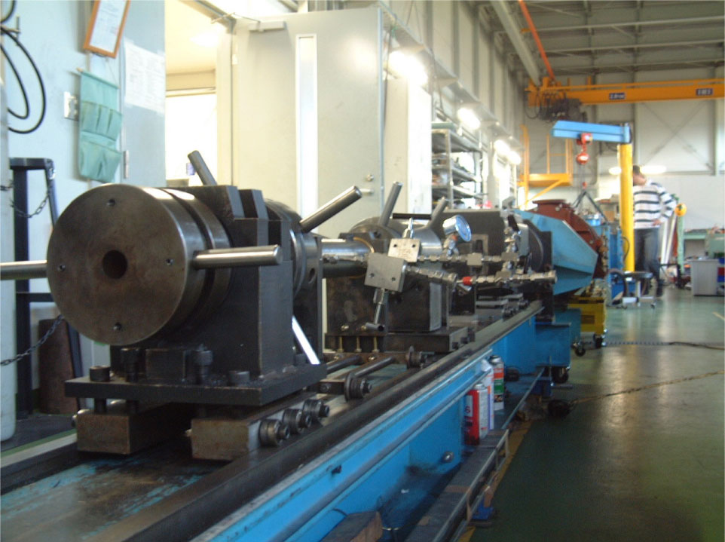
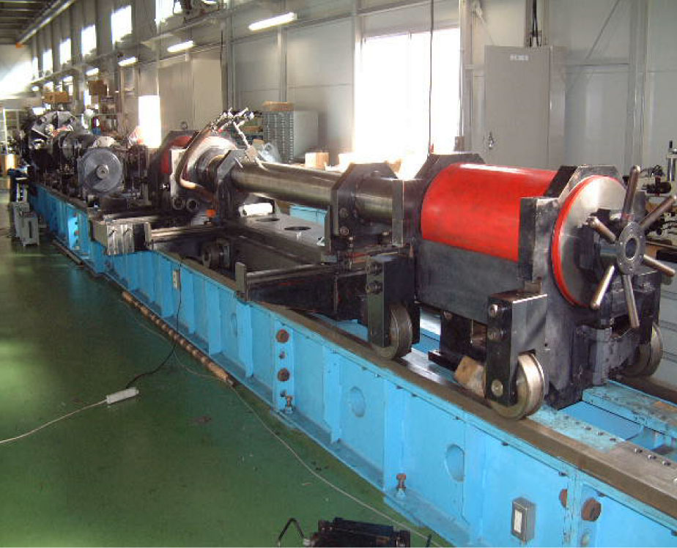
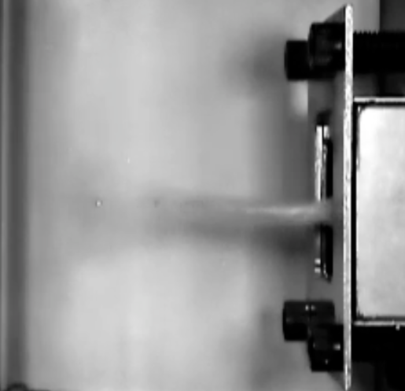
Hypervelocity Impact Test Facility
Multiple two-stage light gas guns up to 6.2km/s
Contributing to ISO standardization of hypervelocity impact ejecta distribution
Notes:
3 or 4 institutions in Japan have a similar facility.
Kyutech unique in this sense- ISO standards are generally for industry, but require scientific rationale- Kyutech has strong international and industry ties.

Slide 21
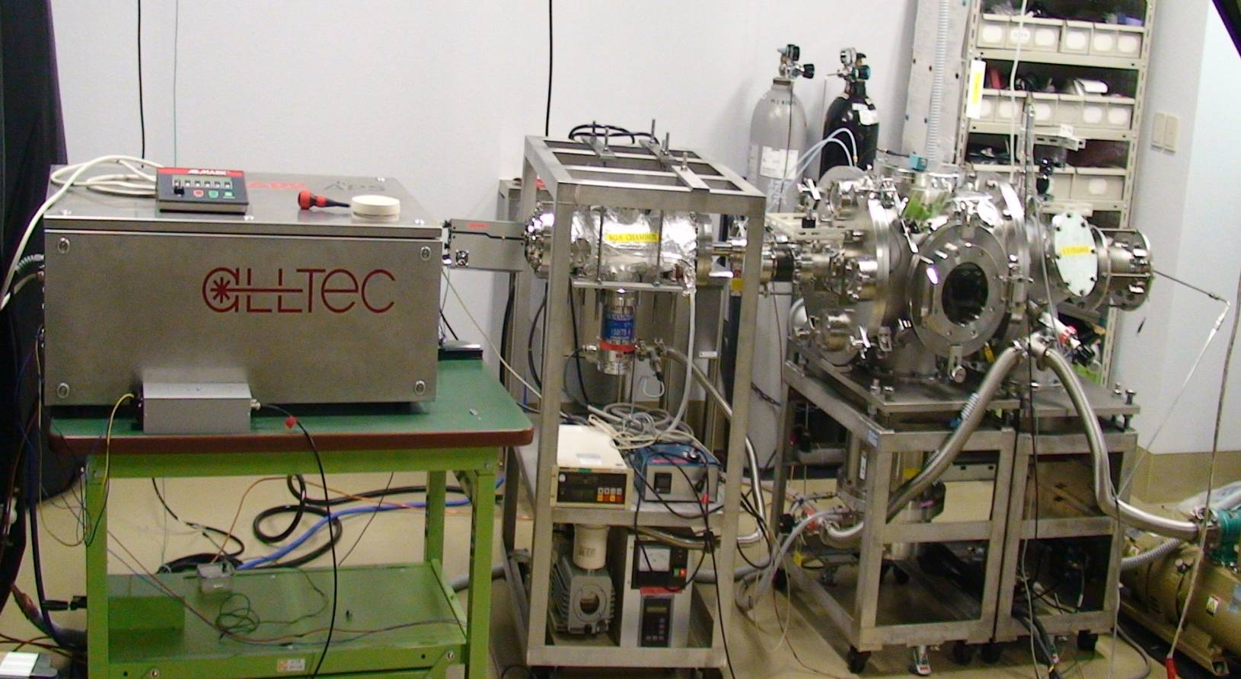
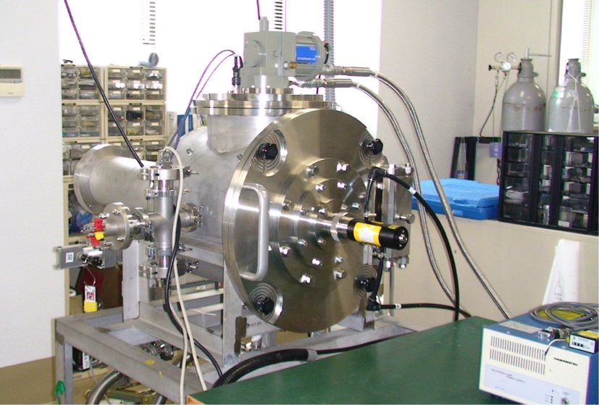






Material degradation
One of three spacecraft material research facilities in Japan
Degraded polymer
Atomic oxygen exposure
UV exposure
Electron emission property measurement
Thermal cycle exposure
Mechanical property measurement
Thermo-optical property
Notes:
Only a few atomic oxygen facilities in Japan, Europe
Polymers very susceptible to radiation

Slide 22
Outline
Introduction to KIT
Introduction to LaSEINE
  Space Research
  Satellite Testing
Kyutech Satellite Projects
SEIC and PNST
Conclusion

Slide 23


ISO standardization of ESD tests
ISO workshop participants
Led the international efforts toward ISO standardization of Satellite Solar Panel ESD Ground Test Method
  Published as ISO-11221 on August 1st, 2011
Participants from US, Europe, China, India, etc
Certification of solar arrays made by foreign manufacturers
  US, China, India, etc
Notes:
Cho sensei project leader of ISO standardization of satellite solar panel ESD ground test method (certify test method to streamline testing, failure fallout, etc.)
Took 5-6 years, published 2011. China and India sent engineers to Kyutech for training.

Slide 24

NETS Project
“Nanosatellite Environment Test Standardization” (NETS) project
  Sponsored by Ministry of Economy, Trade and Industry (METI), Japan, starting September 2011
  3 years project until March 2014
Project goal
  ISO standards on nanosatellite testing
    Environment Tests of Nanosatellite System
    Documentation of Nanosatellite Environment Tests
    Environment Tests of Nanosatellite Components
International Workshop (December 2011)

Slide 25





Center for Nanosatellite Testing
Established in 2010
Provides all the environmental test services except radiation for :
  Nanosatellites up to 50cmx50cmx50cm and 50kg
  Equipment worth more than 2 million US$
Tested or testing 20 nano-satellites for Japanese universities or industries
Notes:
Since its inauguration in 2010, the center for nanosatellite testing has provided environment tests to 15 nano-satellite for Japanese universities or industries.
To open a similar-type facility, need ~$5M (not counting building, clean room, etc.). Cost can be reduced by using university infrastructure- ~$2M in our case. All domestic, but steps taken to reduce cost- refurbishing thermal vacuum chamber ($700K anyway), etc.

Slide 26










Nano-satellite environment tests
To be capable of doing all the tests for a satellite up to 50cm, 50kg
EMC & Antenna pattern
Pressure & Leak
Vibration
Thermal vacuum
Assembly & Integration
Vacuum thermal shock
Thermal cycle
Outgas
(ASTM E595)
Shock
α&ε measurement
Notes:
The laboratory is capable of doing all the environment tests for a satellite up to 50cm, 50kg.
Had chance to obtain radiation facility about 5 years ago from physics professor, said no- too much infrastructure- maybe make different choice now.

Slide 27
Japanese nanosatellites from 2012
2012 (H2A):HORYU-II (7kg)
2012(H2B to ISS):FIT, Meisei, Wakayama U (all 1.5kg)
2012(PSLV):Proiters (10kg)
2013(Cyclone, Brazil):Nano-Jasmine(35kg)
2013(Denepr):Hodoyoshi-1, QSAT-EOS, TSUBAME, Nagoya-sat (all 50kg)
2013(Russia): WNISAT (10kg)
2013(TBD):Hodoyoshi 2,3,4
2013(H2A):Kagoshima U., Kagawa U., Teikyo U., Shinshu U., Tama-art U., Osaka Pref U., Tsukuba U.
2013(H2A) Rising 2 (43kg), UNIFORM-1 (50kg), SOCRATES(50kg), SPROUT (27kg)
2014 (TBD) CE-SAT
2015 (TBD) HORYU-IV
CENT is involved in 17 satellites out of 26 satellites
Notes:
Blue satellites tested by LaSEINE/CENT. WNISAT already launched, other 2013 satellites will launch ~Jan- April 2014
JAXA considered opening a “small” AIT test facility, however, personnel cost too high, JAXA shut down test center. Kyutech subsidized, only full scale Japanese “small” satellite test center.

Slide 28
Strength of LaSEINE
Originality of research theme
  Not many people do space environment technology, but it is necessary to make a satellite
Hardware and knowledge about space environment technology
Internationality
  Partnership with
    NASA, Space Systems Loral, Lockheed Martin, Naval Research Laboratory, Ohio Aerospace Institute, University of Southern California
    CNES, ONERA, Thales-Alenia, EADS/Astrium, University of Surrey, International Space University
    Beijing Institute of Space Environment Engineering, Xian Jiaotong University
    Indian Space Research Organization
Support from university, local government and businesses

Slide 29
Outline
Introduction to KIT
Introduction to LaSEINE
  Space Research
  Satellite Testing
Kyutech Satellite Projects
SEIC and PNST
Conclusion

Slide 30


Kyutech Satellite Projects
Kyutech nanosatellite project
  25 graduate and undergraduate students working together
    Responsible for all the processes
      Conceptual study, design, fabrication, testing and operation
Official educational program for graduate students
  Learn systems engineering and project management
  Writing a Ph.D thesis
    Extract a state-of-the-art research element from the project work
HORYU-I
HORYU-II
(Launched on May 18, 2012)
Notes:
Kyutech has its own student satellite program. The satellite program is regarded as an important educational program of systems engineering. Currently about 25 students work on the satellite project. They are responsible for all the processes of satellite development, which range from conceptual study, design, fabrication, testing and operation. The photographs shown here are flight models of 10cm and 30cm cubesats. In May, 2012, HORYU-II was successfully launched to a sun-synchronous orbit by a H2A rocket.
The satellite project is being carried out as a part of the official educational program for graduate students. The students earn their credits by working on the satellite project as they learn important lessons of systems engineering from the project. Also, some students write their Ph.D. thesis by extracting a state-of-art research element from the project work.

Slide 31


Kyutech Satellite Projects
HORYU-I
Student Satellite (1U)
HORYU-II
Student Satellite (30cmx30cmx30cm)
2006~2010
2010~
Not launched
Launched (May 2012)
Notes:
~20-30 Japanese universities working on Cubesats, as are small companies. Tried to launch HORYU-I on Indian PSLV rocket, launcher interface issue. HORYU-II “free” launch on H-IIA.
HORYU means “phoenix-dragon bird/creature combination”. KIT symbol- represents that science/technology can attain the previously unachievable: https://www.kyutech.ac.jp/english/about/emblem/
~$60K to develop HORYU-I, ~$200K for HORYU-II (including ground station).

Slide 32



Development history
May, 2006: Kick-off of student satellite project
Aug, 2006: Definition of main mission
  Material degradation observation
Aug, 2008: Redefinition of mission
  Priority: Education
  Simplification of satellite design
    1U CubeSat with a CMOS camera only
March, 2010: Completion of flight model (HORYU-I)
Image of HORYU (2006~2008)
Image of HORYU (2008~)
HORYU-I flight model

Slide 33

Development history
April, 2010: Decided to apply for the H-2A launch with a different satellite, HORYU-II
April, 2010: Definition of new missions
  High voltage technology demonstration
  Short development schedule (1 year) required to use the heritage of HORYU bus systems
August, 2010: Resubmission of the proposal
  Adaption of 25 years de-orbit rule excluded CubeSats
  30cmx30cmx30cm (but only 7kg!) cubic shape adopted
September, 2010: Selected for the H-2A launch in Fall, 2011
  Halt the launch contract of HORYU-1
  Concentrate on HORYU-II
  “If you chase two rabbits, both will escape”
3U configuration of HORYU-II
Configuration of HORYU-II to comply with 25 years rule
Notes:
HORYU-I 1U attempted Indian launch but concerns over “proven” separation system

Slide 34


High Voltage Technology Demonstration Satellite
HORYU-II
Camera
Solar array with arc mitigation design
Surface charging sensor
300V Photovoltaic power generation
Electron-emitting film
Debris impact sensor
Developed by students of Kyushu Institute of Technology
30cm cube, 7kg
680km, Sun-synchronous orbit
Demonstration of high voltage (300V) solar array technology
The first time to use solar array to make 300V (no DC/DC converter!)
Amateur radio band, passive attitude control

Slide 35






Satellite Models
BBM
Structure Thermal Model (STM)
Flat-sat Model
Engineering Model (EM)
Flight Model (FM)

Slide 36
Design constraints of HORYU-II
Shortage of
  Schedule
    Have to deliver the satellite in one year from the launch award
  Technical skill and expertise
    Students are responsible for the satellite development
    No technology beyond their skill should be used
  Budget
    No space qualified components

Slide 37

Development strategy of HORYU-II
Inherit design of HORYU-I as much as possible
  Verified to a certain extent
  Know the detail
Suitable for technical levels of students
  Passive attitude control
  Minimum deployment
    Antenna only
  Outsourcing
    Soldering of electronics parts
    Structure machining
    based on drawing made by students
  Solar array (bus-system) acquired from Sharp Co.
    Solar cells are interconnected by Sharp Co.

Slide 38
Development strategy of HORYU-II
Schedule > Cost
  Multiple components for parallel development
    3 identical circuit boards at each stage
Test as much as possible
  Make use of in-house facilities at KIT
Risk management
  Try to avoid single-point-of-failure as much as possible
    There are limits though
Requirement based project management

Slide 39
Test cost (person x day)
Tests | Total | STM | EM | EM ver.2 | FM
Antenna Pattern | 90 | 90
Vibration | 294 | 110 | 90 | 63 | 31
Electrical Interface | 45 |  | 5 | 26 | 14
Communication | 124 |  | 89 | 23 | 12
Thermal balance | 120 |  | 120
Shock | 185 | 9 | 60 | 50 | 66
Thermal vacuum | 492 |  | 74 | 169 | 249
Function | 31 |  | 8 |  | 23
Baking | 59 |  |  |  | 59
End-to-End | 81 |  |  |  | 81
Inspection | 51 |  |  |  | 51
Mission Payload | 577
Components | 78
Ground Station Operation Rehearsal | 62
Total | 2289 | 209 | 446 | 331 | 586

Slide 40

Days required for each test
Internal circuit boards added

Slide 41


HORYU-II Launch
May 18, 2012 (JST)

Slide 42

300V photovoltaic power generation
Power generation of > 300V
Eclipse period
Charging due to power generation
The world record of the highest photovoltaic power generation in orbit!!
(Previously 160V by International Space Station)
Notes:
Need high voltage for high power/larger spacecraft (minimize transmission loss, etc). HORYU-2 (30cm x 30cm x 30cm for 25-year rule drag purposes) (two year development, one year operation) set world record for highest in-orbit voltage generation (~300V, ~5mA). Guinness Book of World Records application pending.

Slide 43



HORYU-II imaging
13:30, July 17, 2012, Himawari Meteorological Satellite Image
Part of Typhoon-7 was captured!
(although only 168x128 pixels)
Area of image

Slide 44

HORYU-II imaging
Honshu island
(Japan)
Korean peninsula
Kyushu island

Slide 45
HORYU-II conclusion
As a student satellite project, HORYU-II project was quite successful.
Students
  Delivered the satellite on-time after thorough verification.
  Proceeded the project using the basic practices of systems engineering.
The key to the success
  Launch opportunity very likely from beginning of project
  Maintained high motivation

Slide 46

Kyutech Satellite Projects
HORYU-III
Student Satellites (3U)
HORYU-IV
Semi-professional
2013~2015
2013~2017
Launch (2014?)
Launch (2015 or 2016?)
Discharge current acquisition
Discharge current & image acquisition
Notes:
HORYU-III 3U student satellite project (variable in-orbit voltage generation, measure arcing current with oscilloscope)- to be delivered to ISS via HTV and then released.
HORYU-IV research and development satellite. 30cm x 30cm x 30cm; 8 kg. ~$1.5M budget. Will carry oscilloscope and arcing-image capture system. Indian, Russian, or Japanese H-IIB launch (launch is “free”, maximum size/weight is 50cm x 50cm x 50cm, 50 kg. This sets the size of most Japanese “small-scale” satellites).
6U slots are available on each HTV launch (H-IIB). For example, there were 4 Cubesats launched on HTV-4 and later released from the ISS: http://www.nasaspaceflight.com/2013/08/japans-htv-4-launches-supplies-scienceiss/
Pico Dragon, 1U, Japan/Vietnam, Earth imaging technologies
Ardusat-1, 1U, US company Nanoracks, open re-programmable platforms
Ardusat-X, 1U, US company Nanosatisfi, open re-programmable platforms
TechEdSat-3, 3U, NASA Ames, “Exo-brake” aerobraking de-orbit method
HTV has 6U slots per launch (~1 per year?). 4U/2U for Japan/US. HORYU-3 will take 3U 2014 slots. NOTE: HTV collects ISS trash and incinerates upon re-entry.

Slide 47

HORYU-III overview
Main mission: measure discharge current waveform
Sub-missions: Earth imaging, inter-satellite optical communication
Launch: H-IIB HTV-5 to ISS for release

Slide 48

HORYU-IV overview
External structure

Slide 49
ISS Cubesat “launch” program
JAXA releasing cubestas from ISS Kibo module
  JEM- Small Satellite Orbital Deployer (J-SSOD) hardware: 6U
    2 release “pods”, 3U each
    Release 1: http://www.youtube.com/watch?v=G_Br2V3QokI
    Release 2: http://www.youtube.com/watch?v=R0GWszmdlXI
  October 2012 (HTV-3)
    5 cubesats: RAIKO (2U), FITSAT-1, WE WISH, F-1, TechEdSat
  ~November 2013 (HTV-4)
    4 cubesats: TechEdSat-3 (3U), Pico Dragon*, Ardusat-1, Ardusat-X
  ~2014 (HTV-5)
    HORYU-3 (3U) and others
  ~2015 (HTV-6)
    Kyutech/international partner 2-3U satellite? And others
*will release November 19, 21:10 JST. Kyutech will receive CW beacon.
Notes:
J-SSOD launched with HTV-3
Have HTV-4 cubesats been released?
Pico Dragon was Japan/Vietnam
HTV collects ISS trash and incinerates upon re-entry
We need to apply for 2-3U slots for 2015 HTV-6 launch. Note: without propulsion/orbit correction, ~6 month lifetime in ISS orbit.
ISS cubesat 6U are for “Asian-Pacific” countries that join with a Japanese institution.
ANGKASA/ATSB: satellite bus- either or both can be “home team”
NTU: mission payload
Japan: testing and sponsor

Slide 50

Cubesats released from ISS
Reference: Soichi Noguchi, “Capacity Building in Space Technology Development and the International
Space Station”, UN/UAE Symposim on Basic Space Technology, Dubai, UAE, October 20 – 23, 2013
Notes:
6U slots are available on each HTV launch (H-IIB). For example, there were 4 Cubesats launched on HTV-4 and later released from the ISS: http://www.nasaspaceflight.com/2013/08/japans-htv-4-launches-supplies-scienceiss/
Pico Dragon, 1U, Japan/Vietnam, Earth imaging technologies
Ardusat-1, 1U, US company Nanoracks, open re-programmable platforms
Ardusat-X, 1U, US company Nanosatisfi, open re-programmable platforms
TechEdSat-3, 3U, NASA Ames, “Exo-brake” aerobraking de-orbit method
HTV has 6U slots per launch (~1 per year?). 4U/2U for Japan/US. HORYU-3 will take 3U 2014 slots. NOTE: HTV collects ISS trash and incinerates upon re-entry.

Slide 51

Cubesats released from ISS
Reference: Soichi Noguchi, “Capacity Building in Space Technology Development and the International
Space Station”, UN/UAE Symposim on Basic Space Technology, Dubai, UAE, October 20 – 23, 2013
Notes:
6U slots are available on each HTV launch (H-IIB). For example, there were 4 Cubesats launched on HTV-4 and later released from the ISS: http://www.nasaspaceflight.com/2013/08/japans-htv-4-launches-supplies-scienceiss/
Pico Dragon, 1U, Japan/Vietnam, Earth imaging technologies
Ardusat-1, 1U, US company Nanoracks, open re-programmable platforms
Ardusat-X, 1U, US company Nanosatisfi, open re-programmable platforms
TechEdSat-3, 3U, NASA Ames, “Exo-brake” aerobraking de-orbit method
HTV has 6U slots per launch (~1 per year?). 4U/2U for Japan/US. HORYU-3 will take 3U 2014 slots. NOTE: HTV collects ISS trash and incinerates upon re-entry.

Slide 52
Outline
Introduction to KIT
Introduction to LaSEINE
  Space Research
  Satellite Testing
Kyutech Satellite Projects
SEIC and PNST
Conclusion

Slide 53
Space Engineering International Course (SEIC)
&
Post-graduate study on Nano-Satellite Technologies (PNST) fellowship program
Notes:
Now I would like to introduce the details of the post-graduate study on nanosatellite technologies program, which we call PNST in short.

Slide 54
Background
Presentation of UN Basic Space Technology Initiative (BSTI) at 27th International Symposium on Space Technology and Sciences, Tsukuba, Japan in 2009
Mission
  To enhance access to space application tools for sustainable development through building capacity in basic space technology
Objectives
  Respond to the growing interest in many countries to establish indigenous capacities in basic space technology
  Promote international cooperation and information exchange in capacity building in basic space technology
  Others
Kyutech answered the call for collaborations made by UN
Notes:
Four years ago, there was a presentation about the Basic Space Technology Initiative at the 27th International Symposium on Space Technology and sciences that was held in Tusukuba, Japan.
There was call for collaboration made by the UN in order to meet the growing demand from many countries to obtain basic space technology. Kyutech saw our own merit to answering the call made by UN.

Slide 55
Needs of Long-term Fellowship for Capacity Building
Reading books or attending lectures can not make a satellite
Experience the complete cycle of designing, building and testing
  Even better with launching and operating
  Learn through the failures during the tests and the efforts necessary to correct the defects
Long-term fellowship to support students studying abroad and gaining experience through on-the-job training (OJT)
Learn to think and be innovative
  Participate in a satellite project as a team member not as a guest
  Experience necessary to build a facility from scratch in home country
  University-like environment is more suitable than well-prepared comfortable institutions, such as space agencies or industries
Notes:
Let me explain why we need the long-term fellowship programme for the BSTI program. First of all, we can not make satellites simply by reading books or listening to a lecture. We need experience based on on-the-job training. (OJT) We actually need to use our own hands to learn about satellites. In order to gain experience through OJT, short terms such as 1 year or less are not enough. Therefore, a longer period such as 2 or 3 years is desirable. Considering the nature of the BSTI program, the experience gained should not focus only on the fabrication of satellites, but has to include every aspect of satellite development from its design through to testing. It is even better if one has had the opportunity to launch and operate satellites. Even if the students fail, they can learn from that experience.
To promote the space technology build up in developing countries, the students have to be innovative. They may have to build an infrastructure from scratch when they return to their home country. Therefore, they have to think of themselves as a team member not as a guest when joining the satellite development course.
Also, the university atmosphere is ideal to think and learn, as opposed to a fancy space agency where the equipment is well-prepared and maintained. In the university they have to fix the equipment themselves, and in order to fix it, they have to have detailed knowledge of the equipment.

Slide 56
DNST fellowship (2011 and 2012)
United Nations/Japan Long-term Fellowship Programme on Nano-satellite Technologies
Doctorate in Nano-satellite Technologies (DNST)
  2 students accepted every year since October 2011
KIT provides financial support to students entering Doctorate programme (3 years)
  Living expense 80,000 yen/month
  Exemption from the tuition and entrance fees
Extensive research opportunities in core technologies for nano-satellite system development
  Especially infrastructure and satellite testing
Notes:
For the past two years, we ran a fellowship program called Doctorate in nanosatellite technologies, DNST (sponsored only by KIT- government NEXT fellowship support began 2013).
In this fellowship program, Kyutech provided financial support for three years to those who are coming from developing countries or countries in economic transition.
Kyutech offered extensive research opportunities in core technologies for nanosatellite system development especially infrastructure building such as testing.

Slide 57
PNST Fellowship (2013 onward)
Post-graduate study on Nano-satellite Technologies (PNST)
Number of fellowships
  2 students → 6 students (2 for Master and 4 for Doctoral course)
MEXT (Japanese government) fellowship
  Living expense support
  80,000yen/month → approx. 145,000 yen/month
Exemption from the tuition and entrance fees by KIT
Space Engineering International Course (SEIC)
  Post-graduate curriculum in English
  Master (2 years) and Doctorate (3 years)
These changes apply from the class of 2013 (starting Oct. 2013)
Notes:
Because of the success in the past two years, Japanese government granted Kyutech to expand the fellowship program. The program is now called post-graduate study on nano-satellite technologies, PNST, in short.
The number of fellowships has been increased to six from the previous two.
The program now accept the applicants for Master course.
The students will receive Monbukagakusyo (MEXT: Ministry of Education, Culture, Sports, Science & Technology) Japanese government fellowship, which means more support for the living expense.
They are also exempted from the tuition and entrance fees.
From the fiscal year of 2013, the students will enroll in space engineering international course, a post-graduate curriculum offered in English.

Slide 58

DNST/PNST program growth
September 2010
  Diplomatic document exchange between Japan and UN
DNST class of 2011 selection
  36 applicants from 18 countries
    Egypt
    Mongolia
DNST class of 2012 selection
  39 applicants from 25 countries
    Nigeria
    Thailand
PNST class of 2013 selection
  83 applicants from 28 countries
    Egypt
    Singapore
    Sudan
    Romania
    Ukraine
Mongolia
Egypt
DNST/PNST research and space topics
  Vibration testing
  Power systems
  Orbital dynamics
  Satellite and space projects
  And many more

Slide 59



Space Engineering International Course (SEIC)
Begun in April 2013 at the Graduate School of Engineering, KIT
Research toward a Master or Doctoral degree
On-the-job training such as the Space Environment Testing Workshop
Project Based Learning (PBL) through a space project
Lectures in English
  Space Systems Engineering, Satellite Engineering, Space Environment, Environment Testing, Power System, Structure and Material, Dynamics, Propulsion, Plasma, Semi-conductors, and more
Notes:
The Space Engineering International Course will start in April this year.
It mainly consists of four parts.
Research toward master of doctor degree.
On-the-job training
Project based learning
Lectures in English related to space technologies
You can find a brochure near the entrance of this room.
KIT sounding rocket project: launched up to 1000 m

Slide 60
SEIC curriculum
 | Title | Style
1 | Space Systems Engineering | Lecture
2 | Introduction to Satellite Engineering | Lecture
3 | Space Environment Testing | Lecture
4 | Spacecraft Environment Interaction Engineering | Lecture
5 | Satellite Power System | Lecture
6 | Energy Conversion and Plasma Physics | Lecture
7 | Spacecraft Structure and Material | Lecture
8 | Advanced Space Dynamics | Lecture
9 | High-speed Gas Dynamics | Lecture
10 | Space Propulsion | Lecture
11 | Advanced Course of Aerospace Guidance and Control | Lecture
12 | Advanced High Velocity Impact Engineering | Lecture
13 | Semiconductor Power Devices | Lecture
14 | Heat Transfer | Lecture
15 | Space Environment Testing Workshop | Laboratory Workshop
16 | Practical System Engineering Design | Project
17 | Japanese for Beginners | Lecture
18 | English III | Lecture
19 | Internship

Slide 61
SEIC student composition
Ph.D.
  Egypt x2, Mongolia
  Thailand, Nigeria, France
  Romania, Ukraine
  Japan
Master
  Vietnam x2, Nigeria, Sudan, Singapore, France
  Japan x8
Mixture of 14 foreign and 9 Japanese students
Supported by PNST

Slide 62
How to apply to PNST?
Application package: http://www.unoosa.org/oosa/en/SAP/bsti/fellowship.html
  or
Google: “BSTI Fellowship”
The application deadline is January 27, 2014
For further details, please contact
cho@ele.kyutech.ac.jp (KIT)
jpolansk@tobata.isc.kyutech.ac.jp (KIT)
werner.balogh@unoosa.org (UN)
Notes:
Application processes for class of 2013 have already started. The application packages are on the website. Please note that the application deadline is February 28, 2013, that is the end of this month. You can find a brochure near the entrance of this room.

Slide 63
Conclusion
Various educational activities at Kyutech
  Ground-based space research facilities
  On-orbit experiments
  Satellite project launched and operated: HORYU-II
  Satellite projects underway: HORYU-III and HORYU-IV
  Unique facilities for spacecraft environment interaction engineering research
Japan/UN PNST long-term fellowship for Masters or Doctoral degree
  Full tuition and stipend support for 2 or 3 years
Kyutech accepting international students for SEIC (PNST not required)
  Basic space technology by hands-on experience in nanosatellite testing and development
  Fellowships may be available

Slide 64
Next Topics
ISO “small-scale” satellite NETS standardization
HORYU-II details
HORYU-IV details
Mexican space activities
Collaboration discussion

